Slide 1
Optimizing Brain Tumor Segmentation using Transfer Learning
Team members:
Aadithya Kandeth 6980-2791
Sai Nikhil Dondapati 2228-6439
Shaanya Singh 3476-2752

Slide 2
Why Brain Tumor Segmentation
To assist in Medical diagnosis, early detection and treatment
Clearly differentiate between different tumors
Leverage Deep Learning applications in Medical Imaging
Offer quantitative analysis
Manual segmentation is time consuming
Need for automated segmentation
Standardize MRI based segmentation
Extend to different forms of imaging
Survival prediction
Risk factor identification

Slide 3
Challenges in Brain Tumor Segmentation
Heterogenous shapes and sizes of brain MRIs
Difference in methodologies of capturing MRIs
Different forms of imaging
Different stages of tumor progression
Different types of tumor cells
Different shapes and sizes of tumor cells
Irregular boundaries of tumor cells
Huge imbalance in the dataset
Developing custom evaluation metrics
Generalization for different forms of data

Slide 4
Objectives
Conduct Literature Review
Use state of the art methods for Brain Tumor Segmentation
Optimize the training process by applying transfer learning
Compare performance of different models
Compare and contrast different transfer learning models
Explore 2D modeling along with 3D modeling
Explore evaluation methods for handling class imbalance
Evaluate training times of different architectures and methods
Train, test, and validate different models
Identify the scope for future work

Slide 5
Literature Review
Emerging trend is to use Deep Learning for Medical Imaging
CNNs have been proven to work well for segmentation tasks
Transfer learning has been an effective method
Lack of generalized Brain Tumor Segmentation models
Privacy concerns and variance in imaging methodology
Limited availability of pretrained 3D models
Even scarce when it comes to tumor segmentation pretrained models
U-net has been the winning architecture in recent BrATS challenges
Other architectures include VGG-16 and Resnet-50
Literature for understanding different evaluation metrics

Slide 6
Dataset preparation
We extensively use BraTS challenge datasets publicly available
Extract patches of 128*128*128 from Brain MRI volumes
t1ce, t2, and flair images are used, therefore we have 3 input channels
Input dimension is therefore 128*128*128*3
GD-enhancing tumor: Label 3
Peritumoral edema: Label 2
Necrotic and non-enhancing tumor core (NCR/NET): Label 1
Normal/Non-tumor: Label 0
Output dimension is therefore 128*128*128*4
Our model essentially classifies each pixel as one of the 4 labels

Slide 7
3D Modeling
Without transfer learning
Baseline CNN 3D model (architecture from Project 2)
U-net architecture for 3D modeling
VGG-16 based architecture for 3D modeling
With transfer learning
VGG-16 based architecture for 3D modeling with transfer learning
Resnet-50 based architecture for 3D modeling with transfer learning
Pretrained and imagenet weights used in both cases

Slide 8
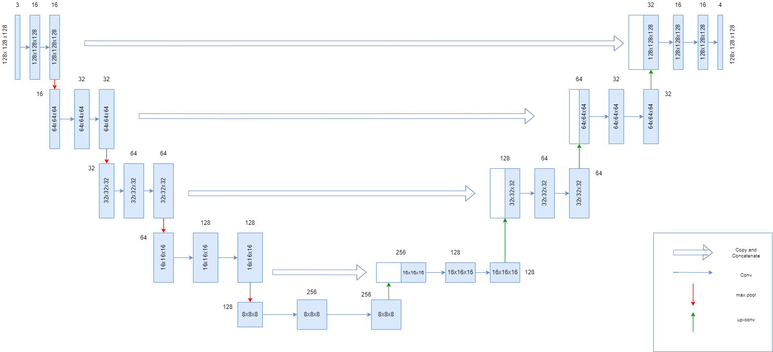
U-net architecture for Brain Tumor segmentation

Slide 9
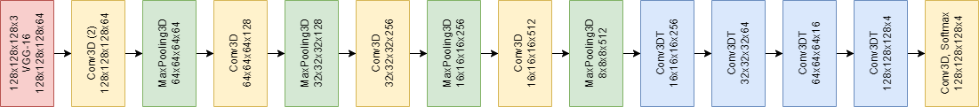
VGG-16 architecture for Brain Tumor segmentation

Slide 10
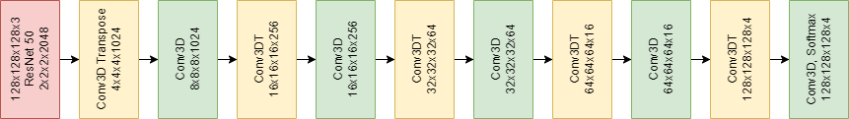
Resnet-50 architecture for Brain tumor segmentation

Slide 11
Evaluation metrics
We cannot rely on accuracy alone because of the huge class imbalance
Easy to achieve more than 90% accuracy by classifying every pixel as non-tumorous
Based on literature review and class lectures, we use the following metrics and loss functions:
IOU score (Intersection over Union)
Dice Loss (Extensively used for segmentation tasks)
Categorical Focal Loss
Categorical Cross Entropy Loss
Metrics in our models are IOU score and accuracy
Total loss as sum of dice loss, categorical focal loss, and cross entropy loss

Slide 12
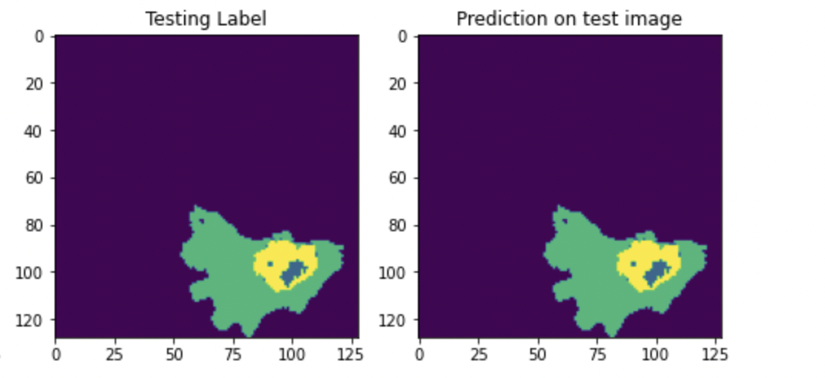
Results
U-net predictions when there are a lot of tumor cells

Slide 13
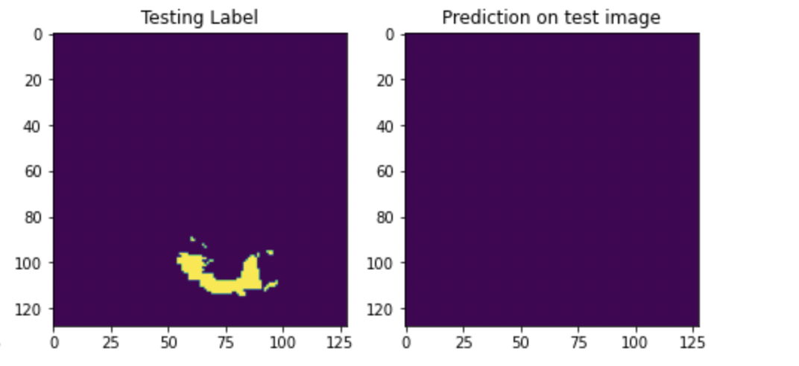
Results
U-net failing when there aren’t a lot of tumor cells

Slide 14
Results
Model | Approach | Accuracy | Mean IOU
U-net | No transfer learning | 0.97 | 0.83
VGG-16 | No transfer learning | 0.94 | 0.74
VGG-16 | Transfer learning | 0.94 | 0.63
Resnet-50 | Transfer learning | 0.95 | 0.67
Baseline CNN | No transfer learning | 0.75 | 0.24
Models trained on 258 training MRI images and validated on 86 MRI images

Slide 15
Training time
Model | Approach | Training time per epoch
U-net | No transfer learning | 1hr 35 mins
VGG-16 | No transfer learning | 1hr 45 mins
VGG-16 | Transfer learning | 16 mins
Resnet-50 | Transfer learning | 13 mins
Baseline CNN | No transfer learning | 23 mins
Models trained on 258 training MRI images and validated on 86 MRI images

Slide 16
Challenges
Very long training time for each model when transfer learning methodology is not used
When the tumor cells are only a small fraction, the models fail
Improving generalization is a tough task
Very limited 3D pretrained models
Proposed Solution
Extract 2D images from the MRI volumes and build models on 2D images
Several pretrained 2D models readily available
Rapid training process
Reconstruct 3D mask by post-processing
Compare results of 2D and 3D modeling

Slide 17
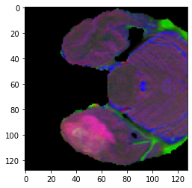
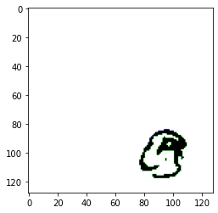
2D image extraction
We extract 2d images from MRI volumes by slicing the data
We customize 2D pretrained models for solving the task at hand
One slice of MRI image is 128*128*3
The same slice of tumor mask

Slide 18
2D Modeling with transfer learning
Inception net V2
Inception resnet
VGG-16
Resnet-50
We use the same evaluation metrics discussed earlier
We make use of pretrained models trained on imagenet
Training process is much quicker
Reconstruct 3D mask from predicted 2D masks

Slide 19
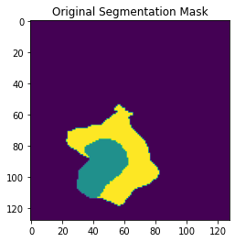
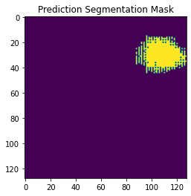
Results
Best results obtained with 2D Inception resnet model

Slide 20
Results
Model | Approach | Accuracy | Mean IOU
Inception resnet | Transfer learning | 0.87 | 0.53
Inception net | Transfer learning | 0.76 | 0.61
Resnet-50 | Transfer learning | 0.51 | 0.25
VGG-16 | Transfer learning | 0.61 | 0.32
Models trained on 33024 (258*128) training 2D images and validated on 11008 (86*128) 2D images

Slide 21
Training time
Model | Approach | Training time per epoch
Inception resnet | Transfer learning | 9 mins
Inception resnet | No transfer learning | 25 mins
VGG-16 | Transfer learning | 11 mins
VGG-16 | No Transfer learning | 43 mins
Renet-50 | Transfer learning | 10 mins
Resnet-50 | No transfer learning | 13 mins
Inception net V2 | Transfer learning | 12 mins
Inception net V2 | No transfer learning | 27 mins
Models trained on 33024 training 2D images and validated on 11008 2D images

Slide 22
Summary & Conclusion
3D models clearly outperform 2D models
Pretrained models are easy to train, and they offer better generalization
The concatenation layers in U-net model help boost the IOU score
Necessity for training the models on lot more data
Inter domain knowledge transfer is challenging
Importance of selecting good evaluation metrics
Handling sparse data is a challenging

Slide 23
Future work
Train the models on large datasets collected from multiple sources
Develop repositories of pretrained 3D Medical Imaging models
Experiment with GANs for Segmentation challenges
Automatic Brain Tumor Segmentation
Incorporate synthetic data to overcome privacy issues

Slide 24
Acknowledgement
We thank Prof. Corey Toler-Franklin for teaching us all the core Deep Learning concepts necessary for developing this project. This project wouldn’t have been successful without her guidance and support. We would also like to thank Sudarshan for his prompt help whenever required.

Slide 25
References
https://arxiv.org/pdf/2106.07333.pdf
https://link.springer.com/chapter/10.1007/978-3-031-09002-8_30
https://paperswithcode.com/paper/top-10-brats-2020-challenge-solution-brain
https://arxiv.org/abs/2211.01885
https://pubmed.ncbi.nlm.nih.gov/29755716/
https://ieeexplore.ieee.org/document/6975210
https://ieeexplore.ieee.org/abstract/document/8297117
https://arxiv.org/abs/2005.04906
https://link.springer.com/chapter/10.1007/978-3-030-20351-1_32

